Slide 1
DATA SCIENCE
10 WEEK PART TIME COURSE
Computer Vision

Slide 2
AGENDA
Typical Computer Vision Applications
Acquiring
Pre-processing
Blurring and thresholds
Segmentation
Feature extraction: edges, corners and blobs
Motion detection

Slide 3
Typical Computer Vision Applications
DATA SCIENCE PART TIME COURSE

Slide 4

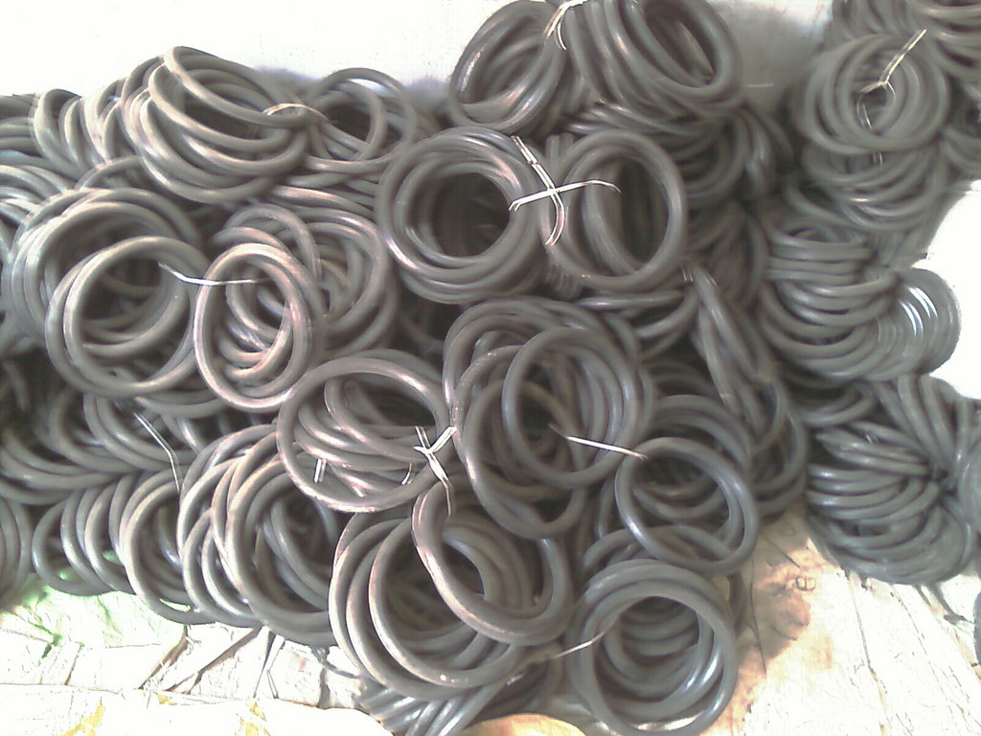
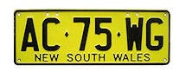
Some projects
Suncorp wanted to know if their home insurance customers had a swimming pool
Satellite imagery + home address + large blue rectangle
A rubber parts manufacturer wanted to count the number of O-rings they were sending out in each order
Photograph + image segmentation
NSW Roads want to read car number plates
Carefully placed traffic cam + character matching

Slide 5
Acquisition
DATA SCIENCE PART TIME COURSE

Slide 6
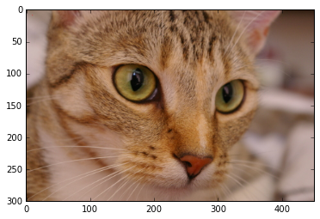
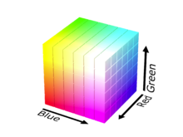
skimage.io.imread(filename)
No standard image format in Python
All libraries have some way of reading a JPEG
Some libraries include “capture from camera”, “frame from video”
Internally stored as a stream of bytes
1024x768 colour images stored as:
1024x768 array of
3 element tuple (red, green, blue) of
Numbers between 0 and 255

Slide 7
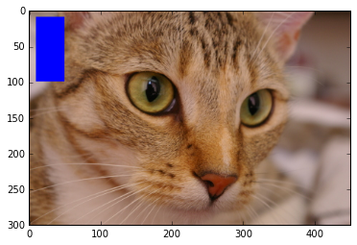
Example
cat = skimage.io.imread(‘chelsea.jpg’)
print cat.shape
(300, 451, 3)
for i in range(10,100):
for j in range(10,50):
cat[i,j] = (0,0,255)
matplotlib.pyplot.imshow(cat)

Slide 8
Pre-processing
DATA SCIENCE PART TIME COURSE

Slide 9
How to turn colour pixels into single numbers
Function call | What it does
skimage.color.rgb2grey() | 0.2125*red + 0.7154*green + 0.0721*blue
image[:,:,2] | Extract blue component only
Write your own | Closeness to a particular colour, unusualness compared to surroundings

Slide 10
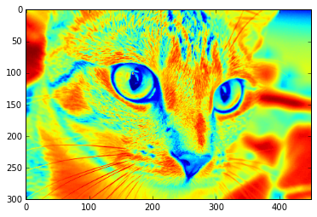
Displaying single-value pixel images
matplotlib.pyplot.imshow(skimage.color.rgb2grey(cat))

Slide 11
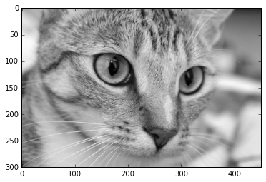
Displaying single-value pixel images
matplotlib.pyplot.imshow(skimage.color.rgb2grey(cat),
cmap=matplotlib.pyplot.cm.gray)

Slide 12
Blurring and thresholding
DATA SCIENCE PART TIME COURSE

Slide 13
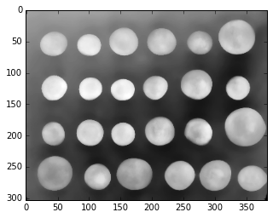
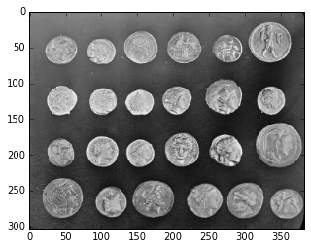
Reducing noise and blurring
The edge of an object will still be an edge even if blurred
A smudge on an object will disappear when blurred
Replace each point with the mean or median of the nearby region
skimage.filters.rank.median(coins,
skimage.morphology.disk(8))

Slide 14
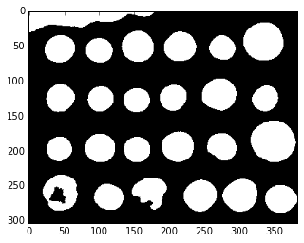
Simple thresholds
Bright = 255, Dark = 0
Can use the numpy array scalar comparison trick
matplotlib.pyplot.imshow(coin_blur > 120,
cmap=matplotlib.pyplot.cm.gray)

Slide 15
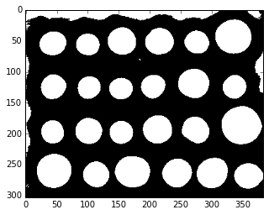
Adaptive thresholds
Threshold is mean of local region
“Local region size” = odd number at least half as big as the features you are looking for
skimage.filters.threshold_adaptive(coin_blur, 301)
Creates a mask (True/False pixels)

Slide 16
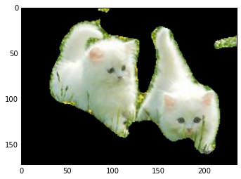
Testing out a mask
copy = original_image.copy()
copy[thresholded_mask == False] = (0,0,0)

Slide 17
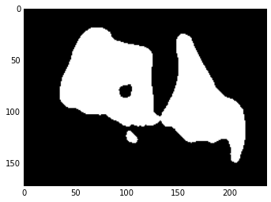
Getting rid of small connections and small objects
Try skimage.morphology.erosion() a few times
(Works on greyscale images)
Sets pixels to the minimum in their neighbourhood
Also try
skimage.morphology.remove_small_objects()

Slide 18
Segmentation
DATA SCIENCE PART TIME COURSE

Slide 19
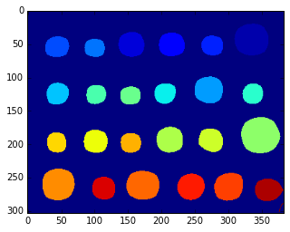
Labeling and counting
Assign a number to each pixel with the value “True”
If two pixels are adjacent and both “True” then they both get the same number
label_array = skimage.morphology.label(binary_image)
print numpy.unique(label_array)
[0 1 2 3 4 5 6 7 8 9 10 11 12 13
14 15 16 17 18 19 20 21 22 23 24 25]
matplotlib.pyplot.imshow(label_array)

Slide 20
Feature detection: edges, corners and blobs
DATA SCIENCE PART TIME COURSE

Slide 21
When we care about feature detection
What if blur + erode + threshold doesn’t work?
Try edge detection + in-fill
Areas of text have lots of corners
Features can be used in machine learning

Slide 22
How to detect edges?
Many names for the same thing:
Differential
Gradient
Difference between adjacent pixel values
Directional change

Slide 23
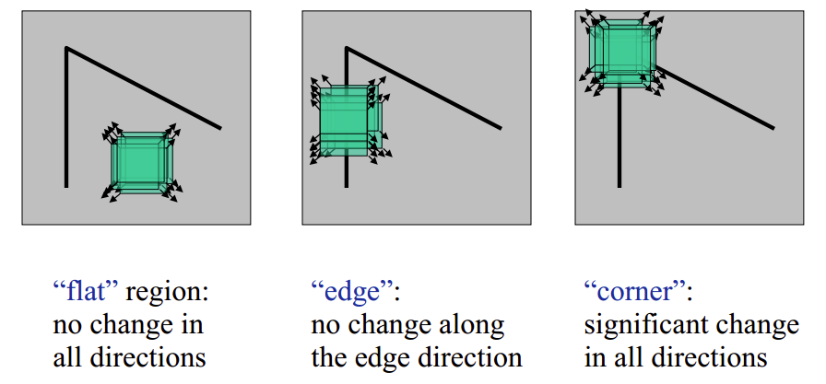
Which do you have?

Slide 24
Common edge detection algorithms
Canny (more accurate)
skimage.feature.canny()
Sobel (faster)
skimage.filters.sobel()

Slide 25
In-fill
scipy.ndimage.binary_fill_holes()

Slide 26
Motion detection
DATA SCIENCE PART TIME COURSE

Slide 27
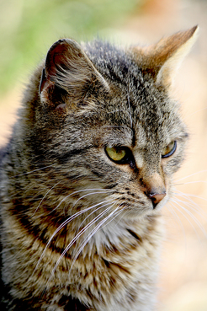
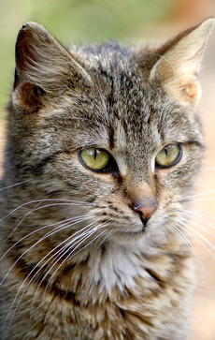
Has my cat moved?
If yes, many pixels will have changed

Slide 28
Comparing images
skimage.measure.compare_mse(im1, im2)
Compare pixel-by-pixel
skimage.measure.compare_ssim(im1, im2)
Compare structural similarity
Compares corners and edges
Copes with noise and brightness changes
im1 – im2 != 0
Creates a mask

